Slide 1
UI Change 16

Slide 2
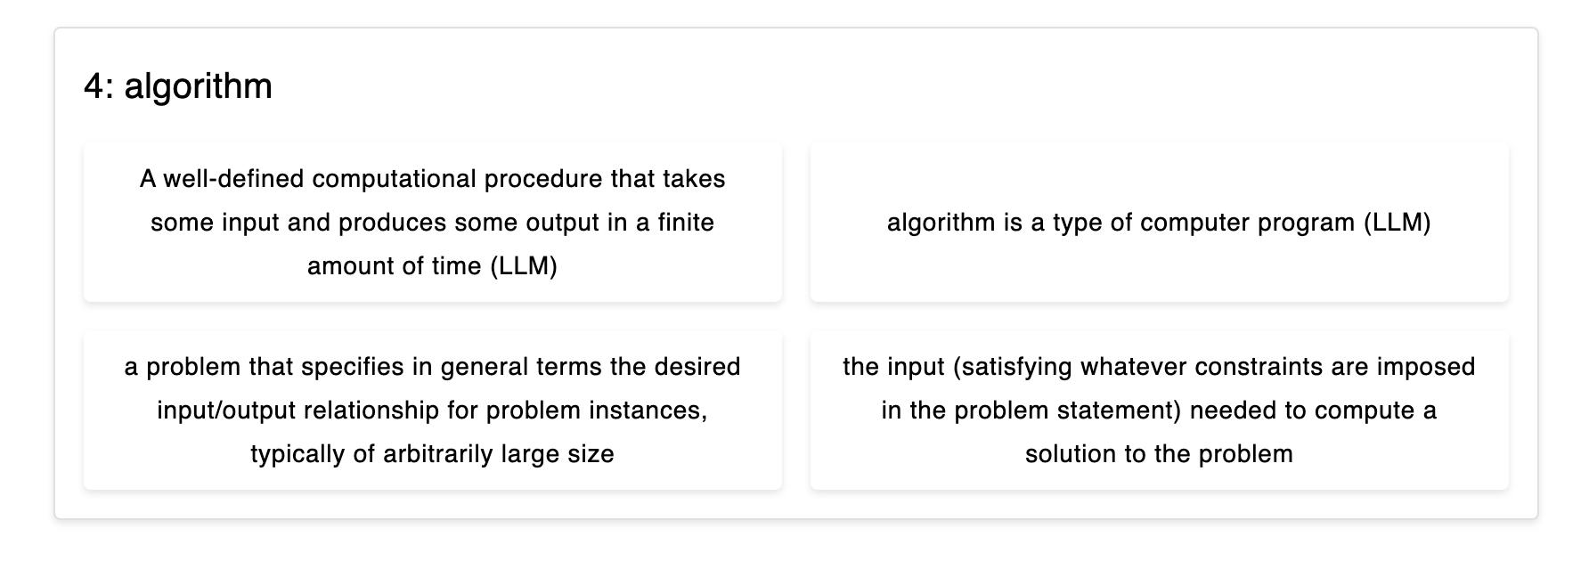
Instead of “(LLM)”, can you make it “(AI)”, thxx

